Slide 1
SMOKE AND GAS LEAKAGE DETECTION SYSTEM
TO DEVELOP AN ARDUINO-BASED SMOKE AND GAS LEAKAGE DETECTOR ALARM TO ALERT ON LEAKAGE AND PREVENT ANY MISHAPPENING
UNDER THE GUIDANCE OF:
Dr. POONAM AGARWAL
PRESENTED BY-
AMAN GOEL

Slide 2
CONTENTS
INTRODUCTION
OBJECTIVES OF THIS PROJECT
COMPONENTS USED
APPLICATIONS
CIRCUIT SCHEMATICS
MQ-135 SENSOR

Slide 3
INTRODUCTION
WHAT IS A SMOKE AND GAS DETECTOR?
A smoke detector is an electronic fire-protection device that automatically senses the presence of smoke as a critical indicator of fire and sounds a warning.
Gas detectors measure or monitor the depletion of combustible gases, toxic gases, and oxygen within an area as part of a safety system and Can sound an alarm to operators in the area where the leak is occurring.

Slide 4
OBJECTIVES OF THIS PROJECT
To study the working principle of gas and smoke detector systems.
To design and develop an Arduino-based smoke and gas leakage detector alarm to alert on leakage and prevent any mishap.
In addition to an alarm, a warning signal (such as glowing an LED) is also aimed here.
To setup up a GSM-based or Wi-Fi-based alert mechanism for remote monitoring of the device (will be my future scope).

Slide 5
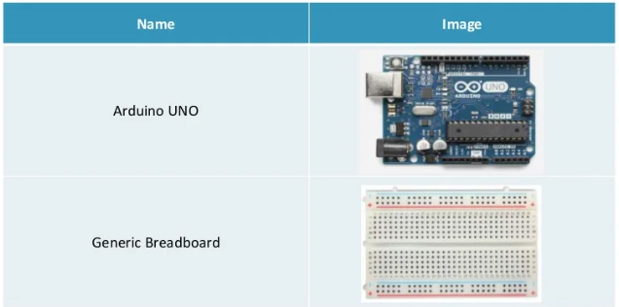
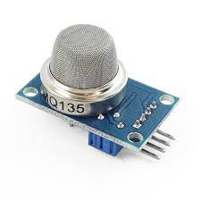
COMPONENTS USED

Slide 6
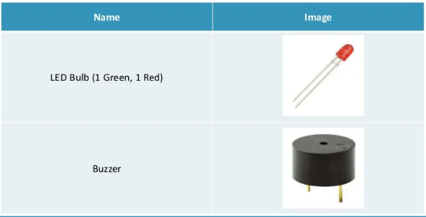
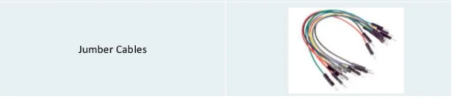

Slide 7
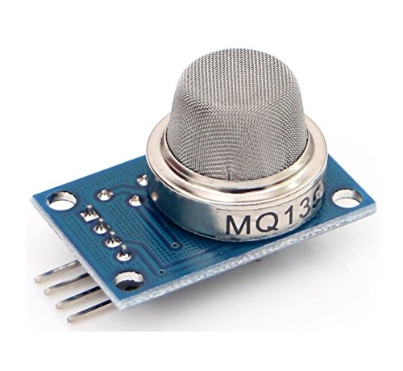
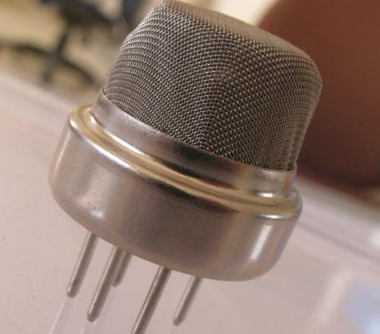

MQ-135 GAS SENSOR
The gas sensor module consists of a steel exoskeleton under which a sensing element is housed. This sensing element is subjected to the current through connecting leads.
The gases coming close to the sensing element get ionized and are absorbed by the sensing element. This changes the resistance of the sensing element, which alters the value of the current going out of it.

Slide 8
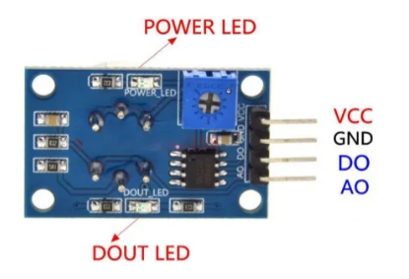
PIN CONFIGURATION
From left to right first pins are as follows:
A0 Analog output
D0 Digital output
GND Ground
Vcc Supply (5V)

Slide 9
FEATURES OF MQ-135 GAS SENSOR
Wide detecting scope.
Fast response and High sensitivity.
Stable and long-life Simple drive circuit.
Used in air quality control equipment for buildings/offices, is suitable for detecting NH3, NOx, alcohol, Benzene, smoke, CO2, etc.
Size: 35mm x 22mm x 23mm (length x width x height).
Working voltage: DC 5 V.
Signal output instruction.
Dual signal output (analog output, and high/low digital output).
0 ~ 4.2V analog output voltage. The higher the concentration the higher the voltage.

Slide 10
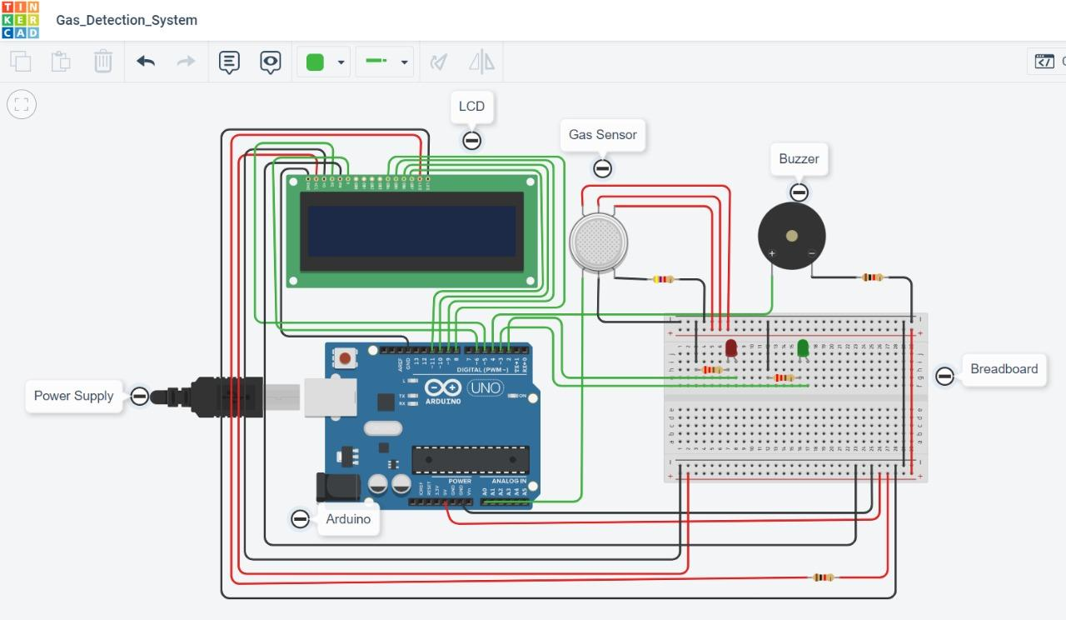
CIRCUIT SCHEMATICS

Slide 11
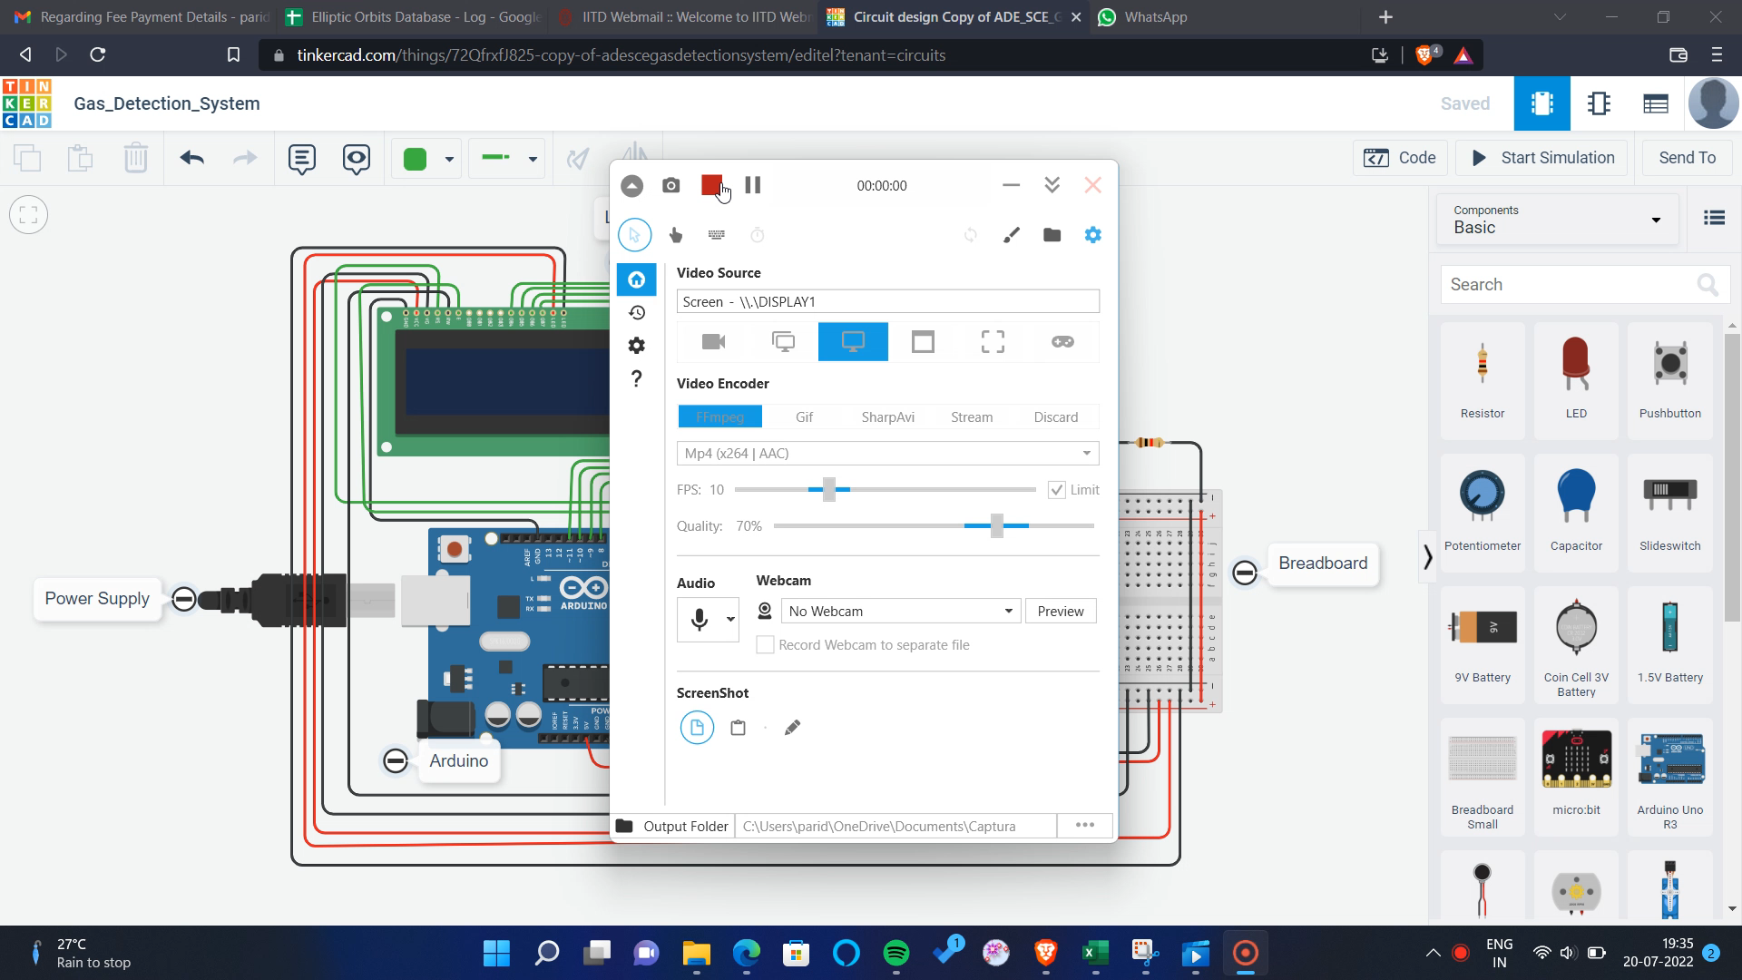

Slide 12
APPLICATIONS
HOME SECURITY: This system is designed mainly for the home(especially the kitchen area) to prevent accidents due to gas leaks.
AUTOMATION: It can be enhanced to automate the electrical cut-off process to prevent short circuits.
ENCHANCEMENT: It can be enhanced to measure specific gas levels for industrial applications.

Slide 13
Thanks for watching!

